Slide 1
Campaign Management
Campaign management – best channel and right time using SQL Server 2016 / R / Power BI

Slide 2
Index
Campaign Management – Introduction & Objective
Key Highlights
Solution Architecture
Execution Steps
Prepare Data
Model Training and Validation
Champion Model Selection
Deploy & Visualize
Analytical dataset Schema
Screen Shots of Solution
R IDE
SQL Server 2016
Power BI Dashboard

Slide 3
Campaign Management – Prediction of Best Channel, Day (of Week) and Time (of Day)
The solution allows the data scientists to deploy an acquisition campaign solution to predict the best channel, day (of week) and time (of day)
The solution is developed for an Insurance Domain
Attributes derived from Demographic details of the leads, historical campaigns and responses are used to make the prediction
The solution allows the business to target customers using the best channel and time for a given product

Slide 4
Identify the best channel, Day and Time for a given Target, Product & Acquisition Campaign
Problem Statement
An analytics solution for Campaign Management is developed to identify the best channel, day (of week) and time (of day) for a given Target, Product and Acquisition Campaign
The solution is developed using Microsoft Products - R, SQL Server 2016, Power Shell and Power BI to develop the solution
Automate the entire Model Building and Production Scoring Process using PowerShell
Execution Steps
Output / Deliverable
Simulate Input Datasets and create Analytical Datasets
Evaluate techniques like Random Forest & Gradient Boosting and identify the Champion Model - to predict the right channel, day of week and time of day
Develop a Power BI Report for results Visualization
Simulated Input and Analytical Datasets
R IDE Codes and SQL Stored Procedures
Power BI based Report
PowerShell Scripts for automation
Documentation

Slide 5





Key highlights of the solution
The solution demonstrates the use of model evaluation and selection techniques to identify the champion model
Proven Machine Learning algorithms are used for Prediction
Machine Learning
*Use of popular ML methods like RF & GBM
Perform data transformations to create derived attributes for Analytical Dataset
Champion Model Selection
*Evaluation of multiple Algorithms
Feature Engineering
*Variable Transformations
Visualization of Prediction Summary and Post Prediction Summary
Visualization
*Power BI Based Visualization
Scalability
*Scalable up to 50 M Records
The solution is automated end to end using PowerShell
Automation
*Power Shell Based Automation
The solution demonstrates the use of model to score large datasets (up to 50M Records)

Slide 6

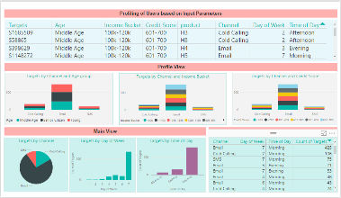
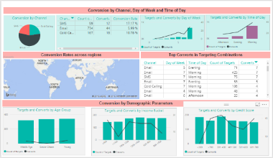

3-layered Architecture - Data, Application (Modeling) and Visualization
DATA LAYER
APPLICATION LAYER
VISUALIZATION LAYER
Simulation of Input Datasets
Lead ID | Channel | Day of week | Time of day | Predicted Conversion Rate
A | Email | Monday | Afternoon | 0.95
B | Cold Calling | Monday | Morning | 0.89
C | SMS | Tuesday | Evening | 0.82
D | Email | Friday | Afternoon | 0.81
Random Forest
Gradient Boosting
Analytical Dataset is trained and tested using Machine Learning Algorithms
4X Input datasets
Illustrative Output
Pre-processing:
Missing Value Treatments
Outlier Treatments
Feature Engineering:
Variable transformations
Recommended Channel, Day (of week) & Time (of day)
Champion Model Selection based on AUC
Illustrative Visualization
The Champion Model is used for Scoring
Production
Dataset
Analytical Dataset

Slide 7
Execution Steps
SQL Server 2016
Prepare Data
Model Training and Validation
Deploy & Visualize
Champion Model Selection

Slide 8
Analytical Dataset Creation.ps1
Simulate Input Datasets and perform data treatments to create Analytical Dataset
Simulation of Input Datasets
Preprocessing & Feature Engineering
Creation of Analytical Dataset
Campaign Detail
Product
Train Dataset
Treated datasets
70%
Campaign Metadata
Product Metadata
Analytical Dataset
4X Input datasets
step1(a)_campaign_detail.sql
step1(b)_product.sql
30%
Pre-processing:
Missing Value Treatments
Outlier Treatments
Feature Engineering:
Variable transformations
Test Dataset
Demography
Market Touchdown
Demographic data of each lead
Historical Campaign Data
step2(a)_preprocessing_market_touchdown.sql
step1(c)_target_demography.sql
step1(d)_market_touchdown.sql
step2(b)_preprocessing_lead_demography.sql
step3_feature_engineering_market_touchdown.sql
step4_ad_creation.sql

Slide 9



Model Development.ps1
Train and test using Random Forest and Gradient Boosting techniques
Train & Test Algorithm 1 - Random Forest
Train & Test Algorithm 2 - Gradient Boosting
Random Forest is an ensemble model is built by recursive partitioning to generate many decision trees
Gradient Boosting is an ensemble model is built by combining the results of many under fitted models
Train Dataset
rxDForest Function
Train Dataset
rxBTrees
Function
Random Forest
Algorithm
Gradient Boosting
Algorithm
Test Dataset
Test Dataset
step5(a)_model_train_rf.sql
step5(b)_model_train_rf.sql

Slide 10
Evaluate for Champion Model and implement it for scoring
Evaluation & Champion Model Selection
Scoring for Prediction
Scoring.ps1
Random Forest
vs
Gradient Boosting
Lead ID | Channel | Day of week | Time of day | Predicted Conv. Rate
A | Email | Monday | Afternoon | 0.95
B | Cold Calling | Monday | Morning | 0.89
C | SMS | Tuesday | Evening | 0.82
D | Email | Friday | Afternoon | 0.81
Illustrative Output
Model Development.ps1
Champion Model selection based on AUC
Statistics like AUC and Accuracy are used to compare the performance of the Model
step6_models_comparision.sql
step7_scoring_leads.sql

Slide 11
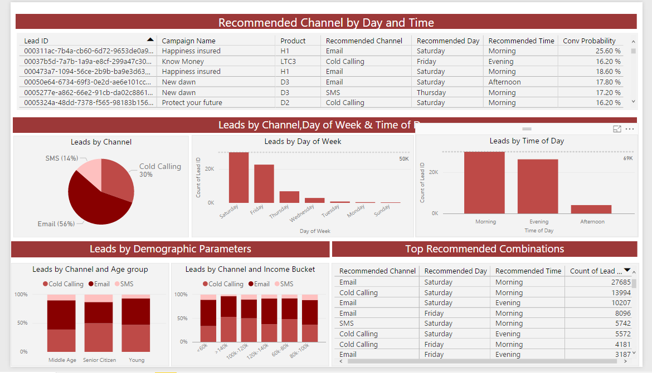
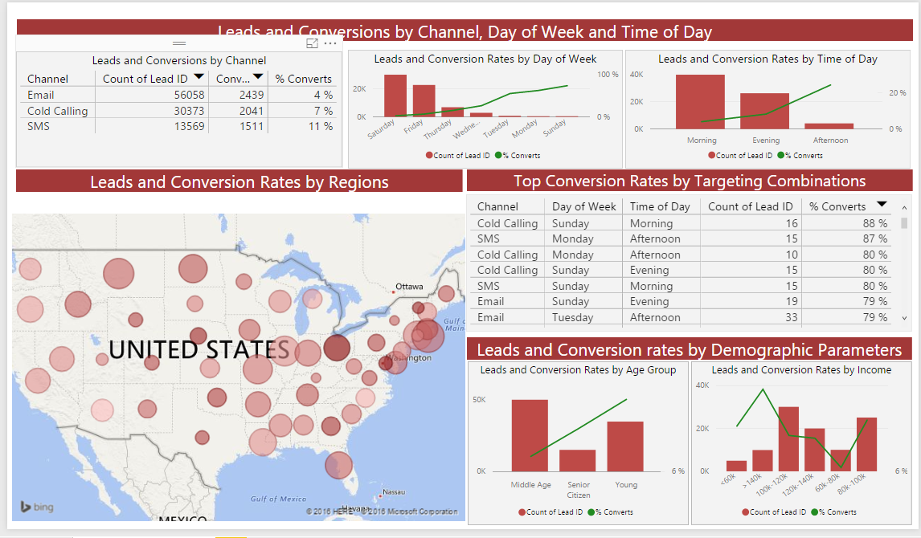
Scoring.ps1
The Champion Model is deployed to Production and the output is pushed to the Power BI dashboard
Recommendations
Campaign Summary

Slide 12
Analytical Dataset Schema
Data Field | Description
Lead_Id | Unique identifier of lead
Age | Age group of the lead
Marital_Status | Marital status of the lead
Credit_Score | Credit Score Range of the lead
Annual_Income_Bucket | Annual Income Range of the lead
No_Of_Dependents | Number of dependents the lead has
Highest_Education | Highest Education of the lead
Source | Source from which the user came into the database
Product | Product Name
Category | Product Category
Term | Number of months of coverage
No_Of_People_Covered | Number of people covered in the policy
Premium | Premium to be paid by the user
Payment_Frequency | Payment frequency of the product
Amt_On_Maturity_Bin | Bucketed Dollar Amount on Maturity

Slide 13
Analytical Dataset Schema
Data Field | Description
Campaign_Name | Campaign Name
Sub_Category | Sub Category of the Campaign
Campaign_Drivers | Drivers for the Campaign
Call_For_Action | Objective of the campaign
Tenure_Of_Campaign | Tenure of the campaign
Action_Day | Integer values showing the day of the week the lead was contacted
Action_Time | Time of day when the lead was contacted
Last_Channel | Channel via which the user was contacted last
Second_Last_Channel | Channel via which the user was contacted the last but one time
#Emails | Number of emails the user has received in the past
#Calls | Number of calls the user has received in the past
#SMS | Number of SMS the user has received in the past
Comm_Frequency | Total number of times the user was touched
Conversion_Flag | Final dependent variable with the value ‘1’ indicating a successful purchase

Slide 14
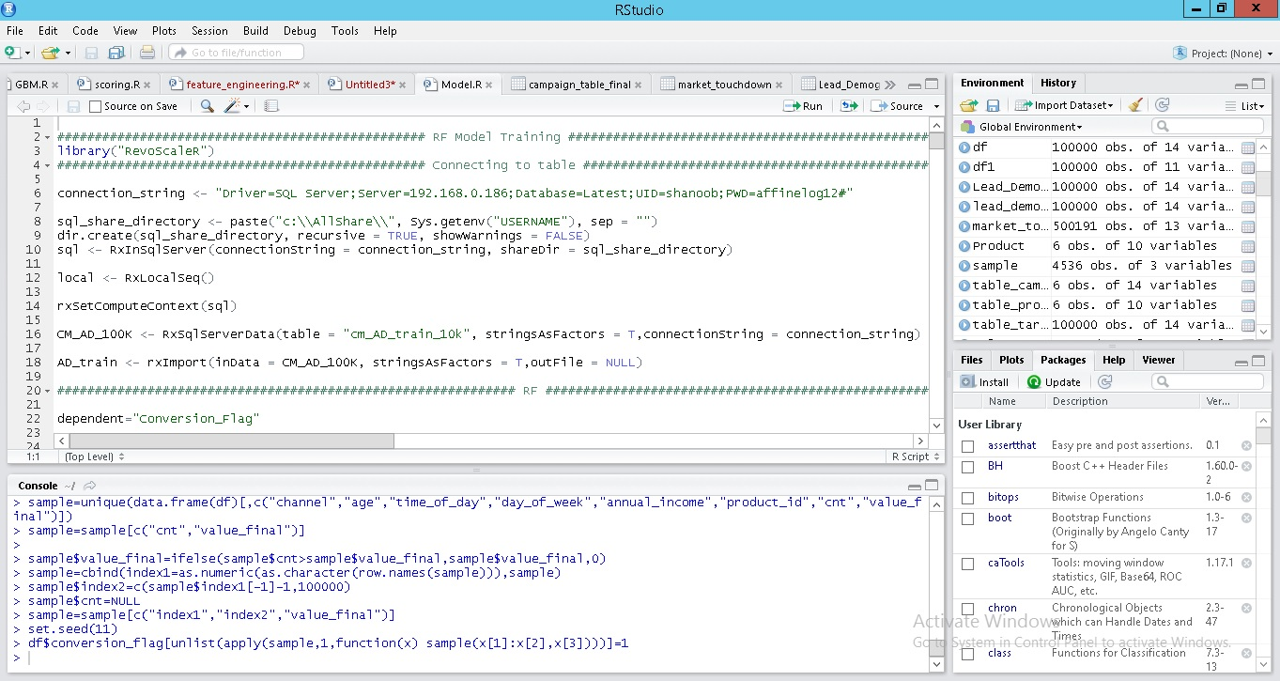
Develop in R Client IDE

Slide 15
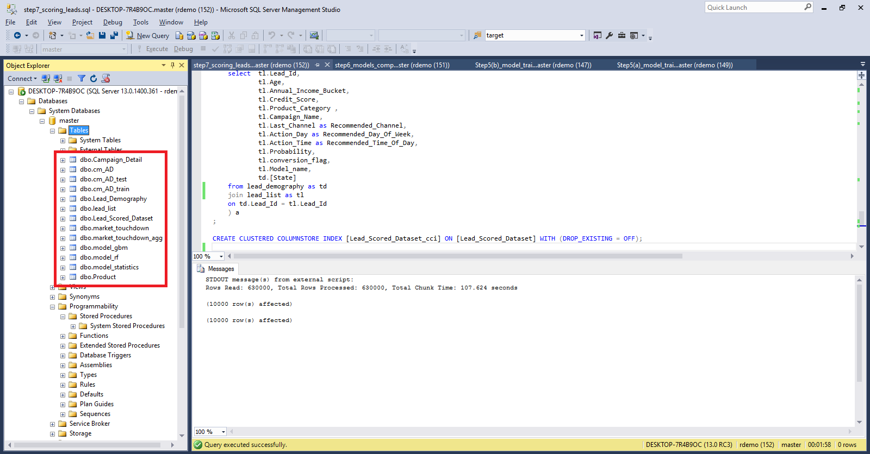

Operationalize In Database

Slide 16
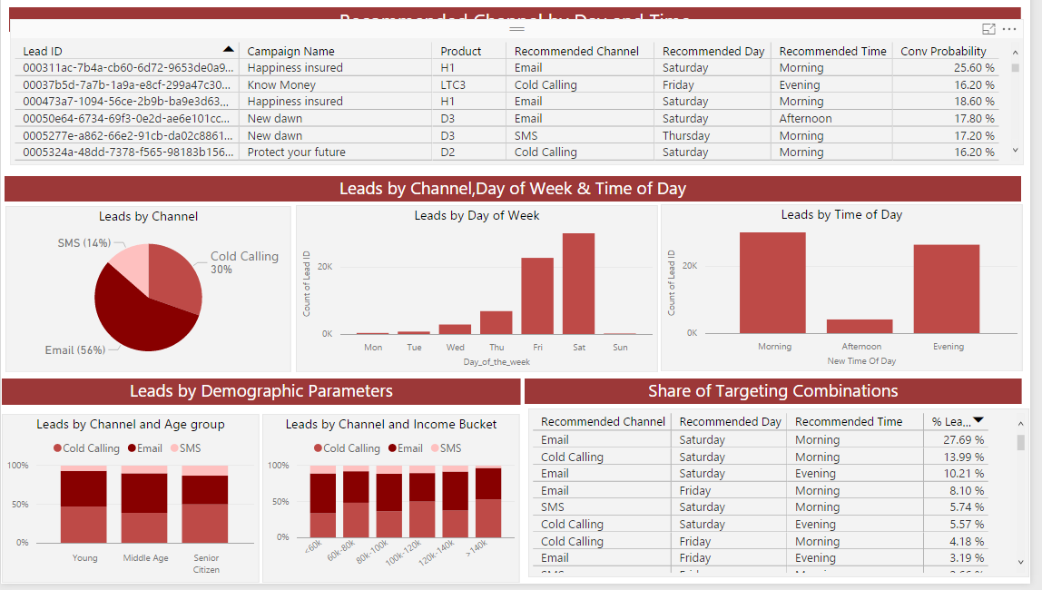
Visualize Data
Power BI

Slide 17
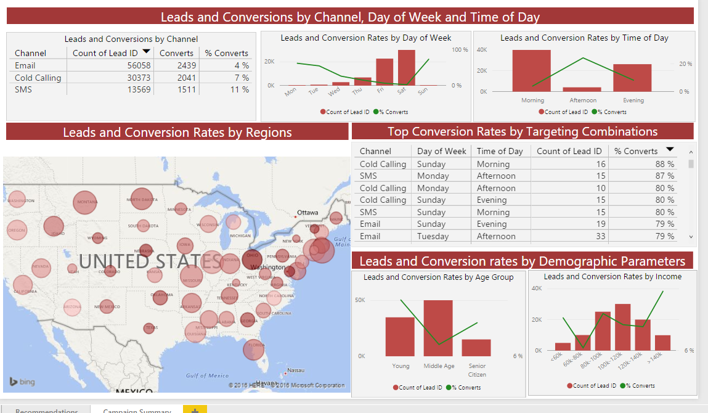
Visualize Predictions
Power BI

